Slide 1
Anonymity-preserving Public-Key Encryption
Markulf Kohlweiss Ueli Maurer, Cristina Onete, Björn Tackmann, and Daniele Venturi
PETS 2013
Notes:
Hello,
I am Markulf Kohlweiss
Thank you for the introduction.
One of the advantages of our approach should be that its easy to teach, so please feel free to interrupt me and ask questions.

Slide 2
Context: Encryption and Anonymity
Public-key encryption
Short but eventful history, late 70s, 80s.
Security usually defined using Games: IND-CPA, IND-CCA, …
Anonymity
Shorter eventful history, early 90s.
Anonymity is arguably a more high-level property
What if used together?
Key privacy, robust encryption, formal analysis of onions
Games prone to require iterations to find “right” notion
Notes:
This is a consolidation of knowledge paper, so what are we consolidating?
Public-key encryption, with RSA and Diffie-Hellman
Anonymity, with remailers and the work of David Chaum
The main question we ask is, what happens if used together.

Slide 3
What is Anonymous Encryption? [PH08]
Sender Anonymity
Receiver Anonymity
Anonymity not created, but preserved
Notes:
There are different flavours of anonymity, and this influences the need for encryption. For sender anonymity, public-key encryption perfectly fits the bill, as encryption key, and thus cipher-text does not depend on the sender.
For receiver anonymity the situation is more interesting, and we focus on it for this reason.
For both settings we note that encryption does not create anonymity, but merely preserves/and alters a property of the underlying channel. We will consider receiver anonymity in a broadcast channel.
The need for receiver anonymity naturally arises when the receiver of a sender anonymous channel wants to reply to the original sender.

Slide 4
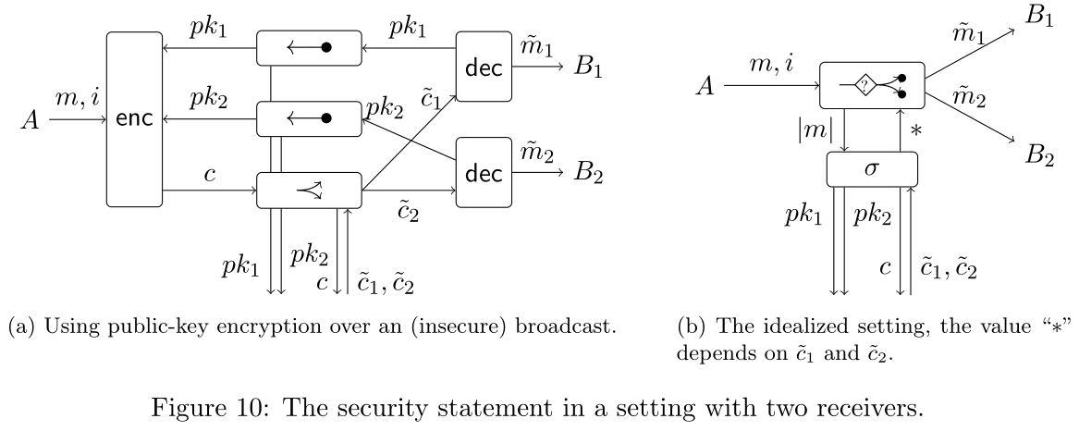
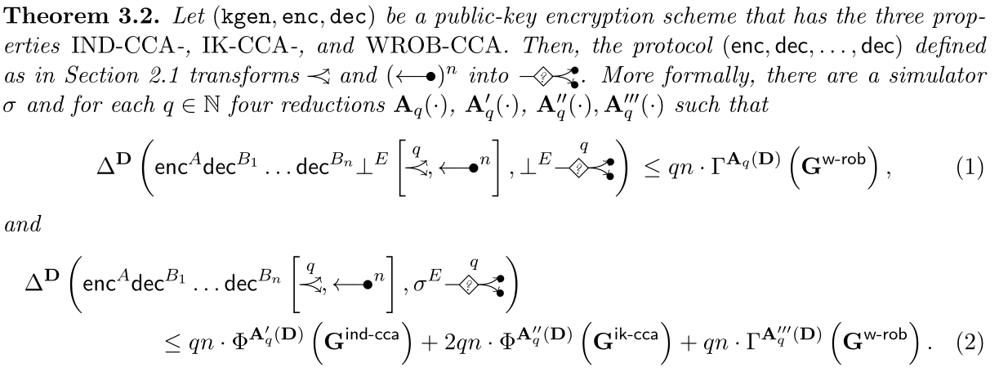
Our contribution
Notes:
This slide is the ultimate summary slide.
We consider the use of anonymous PKE in a broadcast channel.
The public-key is generated by the decryptor, and send over an authenticated (non-anonymous) channel.
The adversary learns the ciphertext c and can replace it with different ciphertexts of his choice.
We investigate the type of channel this protocol constructs.
On the left, adversary Eve, learns the length of the transferred messages, and can influence when and which messages are delivered.
I leave the exact details unspecified for now.
Our main theorem then roughly sais, that if the encryption scheme kgen, enc, dec is secure, key private, and weakly robust, then the above protocol on the left, constructs the channel on the right, in the sense of them being indistinguishable under simulation \sigma.
We give precise bounds, but they don’t matter too much.
Make sure to explain primarily the premis of the theorem here. We will look at the conclusions and its proof later.

Slide 5
Chosen Ciphertext Attack Security (IND-CCA)
Dec
c
Dec(c)
Bit b
m₀, m₁
Enc(m_{b})
bit d
Challenger
pk
d = b?
Notes:
Lets look at how these security properties are usually defined.
The adversary, who is given only the public key of the encryption scheme, is given access to oracles (here a decryption oracle), and then has to win a challenge, (here to guess which message was encrypted).

Slide 6
Key Privacy (IK-CCA) [BBDP01]
Dec₀
Dec₁
Dec₀ (c)
c
c
Dec₁(c)
Bit b
m
Enc(pk_{b;} m)
bit d
Challenger
pk₀, pk₁
d = b?
Notes:
Key privacy is defined similarly.
Given access to decryption oracles, the adversary needs to guess, whether pk1, or pk2 was used to encrypt m.

Slide 7
Weak Robustness (WROB) [ABN10]
Dec
Dec_{i} (c)
c,i
m, i, j
Challenger
pk₁, ..., pk_{n}
c ← Enc(pk_{i}, m)
≠ Dec(sk_{j}, c) ?
┴
Notes:
The third property we need is defined in a game in which the adversary has to produce a message such that the message encrypted with one public key is different from \bot when decrypted with a different secret key.

Slide 8
Constructive Cryptography [MR11]
Resources (existing/assumed, desired):
Available to everyone, including adversary/simulator through interfaces
Converters:
Transform existing into desired resources
Two interfaces, inner and outer
Protocol: composition of many converters, one for each user
Security:
Correctness: without Eve the protocol works correctly
Security: when Simulator connected, no-one can distinguish between assumed and desired worlds.
Notes:
Before I revisit the theorem statement, I want to summarize some concepts of constructive cryptography.
It is called constructive because it is concerned with the study of converters that building more complex resources from existing resources (can be based on physical or cryptographic assumptions).
A protocol is the composition of several converters, one for each user.
Resource has two modes, one without the adversary present, another which accounts for possible adversarial influence.
Security states that in both modes, the protocol with the assumed resources should be indistinguishable from the desired resource and the simulator.

Slide 9
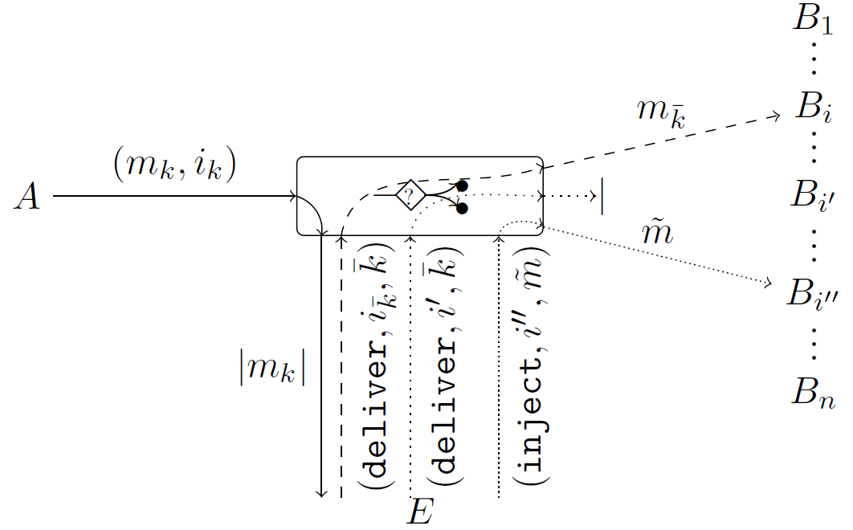
Confidential Receiver-Anonymous Channel
Notes:
This influence is as follows:
Eve can be absent, in which case messages are correctly delivered.
Eve can ask for the conditional delivery of message m_k. If she provides the correct receiver id, the message is delivered, if she provides the wrong one, it is not delivered.
Or she can ask for delivery of messages of her choice at arbitrary recipients.

Slide 10
Notes:
Inequality (1) captures correctness, which relies on weak robustness,
And inequality (2) captures security, both in the sense of the protocol on the left realizing the desired resource on the right. What is missing is a detailed specification of the adversarial influence allowed by the ‘question’-mark channel.

Slide 11
Constructing the Channel from Broadcast
Existing Resources
(pk_{i})
n x
B₁
m
m
m
B₂
m
…
┴
B_{n}
Notes:
How do we construct such a channel from broadcast, and why can’t we achieve more?
We assume that we can distribute public keys using authenticated channels.
And model broadcast as a resource that if Eve is not present delivers the message m at all receivers.

Slide 12
Constructing the Channel from Broadcast
Existing Resources
Converters
(pk_{i})
n x
Encryption scheme that is:
B₁
IND-CCA
IK-CCA
…
m
m*
WROB
B_{j}
m
m*, j
…
B_{n}
Notes:
If Eve is present, she can change the message, and change the recipient to her liking.
In addition we will make use an encryption scheme with all three of the required properties.

Slide 13
Simulation (intuition)
Existing world
Desired world
B₁
B₁
…
…
(c, i)
B_{j}
(m, i)
B_{j}
…
…
B_{i}
|m|
B_{i}
c
…
…
B_{n}
B_{n}
m, i
c
c
m, i
D
Key-Generation: generate n keypairs (for each B_{i}), one separate (sk, pk)
Ciphertext generation: get |m|, encrypt 0^{|m|} under pk to get c
Notes:
We start by distributing keys which are sent over the authenticated channel.
The simulator reproduces these channels towards the E interface and creates an additional key pair sk,pk that is associated with none of the receivers.
He will use this public key to encrypt 0, to simulate ciphertexts.

Slide 14
Simulation (intuition)
Existing world
Desired world
B₁
B₁
…
…
(c, i)
c*
B_{j}
(m, i)
m*
B_{j}
…
…
(c*, j)
B_{i}
|m|
B_{i}
c
…
Dec(c*)
(m*, j)
…
B_{n}
B_{n}
(c*, j)
(c*, j)
D
m*
Ciphertext delivery: deliver c* to B_{j}:
if c* not seen before decrypt under sk_{j} and inject message m* into network
Notes:
When the distinguisher asks for the delivery of a fresh ciphertext c*, decrypt under sk_j and inject message into network.

Slide 15
Simulation (intuition)
Trial Delivery
Assumed world
Desired world
B₁
B₁
…
…
If i = i*
(c, i)
B_{j}
(m, i)
B_{j}
c
…
m
…
(c, i*)
B_{i}
|m|
(H, i*)
B_{i}
c
…
…
m=Dec(c)
B_{n}
B_{n}
(c, i*)
H <-> m
(c, i*)
D
m
Ciphertext delivery: deliver c to B_{j}:
if c seen before deliver corresponding msg. to correct receiver Intuition: this is where we need WROB – wrong receiver outputs error
Notes:
If c seen before, perform a trial delivery. Weak robustness guarantees that c will be rejected by all but the correct recipient.

Slide 16
(More) Results in a Nutshell
WROB sufficient
SROB leads to a tighter reduction
WROB necessary
without WROB, achieve anonymity with erroneous transmission
Impossibility: SROB does not construct better resource
Constructive aspects:
Model network with single sender, many receivers
PK settings: use uni-directional authenticated channels
Trial deliveries prevent better anonymity
Notes:
Other results in our paper include.
WROB is necessary, otherwise channel with erroneous transmission
SROB leads to tighter security reduction
Channel without trial delivery impossible, SROB does not help.
Arguably most complex setting yet targeted by constructive cryptography
Trial delivery opens door for traffic analysis. More complex protocols where messages are processed in the ‘overlay’ network might do better.

Slide 17
Results in Picture
Game-based analysis
Constructive result
IK-CCA
IK-CCA
SROB
WROB
IND-CCA
IND-CCA
Notes:
We model the exact security properties that are needed to achieve receiver anonymous channel based on broadcast.

Slide 18
Strong Robustness (SROB)
Dec
c,i
Dec_{i} (c)
c, i, j
Challenger
pk₁, ..., pk_{n}
both
┴ ≠ Dec(sk_{i}, c)
┴ ≠ Dec(sk_{j}, c)

Slide 19
Notes:
This slide is the ultimate summary slide.
We consider the use of anonymous PKE in a broadcast channel.
The public-key is generated by the decryptor, and send over an authenticated (non-anonymous) channel.
The adversary learns the ciphertext c and can replace it with different ciphertexts of his choice.
We investigate the type of channel this protocol constructs.
On the left, adversary Eve, learns the length of the transferred messages, and can influence when and which messages are delivered.
I leave the exact details unspecified for now.
Our main theorem then roughly sais, that if the encryption scheme kgen, enc, dec is secure, key private, and weakly robust, then the above protocol on the left, constructs the channel on the right, in the sense of them being indistinguishable under simulation \sigma.
We give precise bounds, but they don’t matter too much.

